Slide 1

Masoumeh Sanagou
Department of epidemiology and preventive medicine, Faculty of Medicine, Nursing and Health Sciences, Monash University, Melbourne .

Slide 2
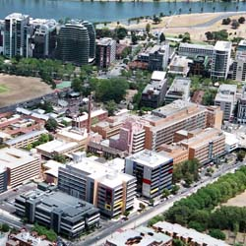
Department of epidemiology and preventive medicine

Slide 3
The risks factors of postoperative complications in patients undergone isolated coronary artery bypass graft surgery

Slide 4
Patients & Purpose
Purpose: to determine risk factors for various postoperative complications for isolated CABG
Patients: The data were collected from the July 2001 to June 2008, 14533 patients underwent isolated CABG

Slide 5
Statistical methods
Risk factors were identified by logistic regression models and using bootstrap technique
The data was divided into two sets including model creation (60%) and model validation (40%) sets.
ROC curves were calculated

